Slide 1
8th Congress APSDA in conjunction with inaSN 2024
Bali,
Indonesia

Slide 2
Date
APSDA 10-12 Oct 2024
10 Oct, Intervention Workshop
11 Oct, Symposium 1
12 Oct, Symposium 2
inaSN 10-13 Oct 2024
10 Oct, Workshop
11 Oct, Symposium 2
12 Oct, Symposium 3
13 Oct, Symposium 4

Slide 3
Location (BALI NUSA DUA CONVENTION CENTRE)

Slide 4
Workshops Location

Slide 5
Scheme WS, 10 oct 2024 (Day 1)
2 Room for Intervention /Wet WS (APSDA)
3 Rooms for Dry WS (inaSN) → 6 Topics

Slide 6
ULUWATU LOBBY

Slide 7
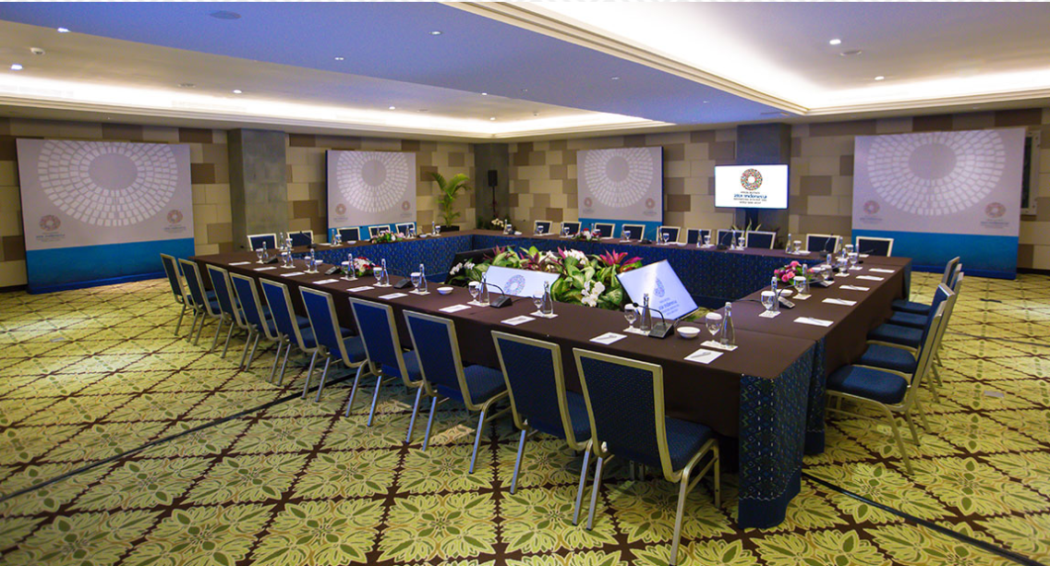
ULUWATU ROOM

Slide 8
Opening Ceremony and Symposiums Location

Slide 9
Scheme Symposiums, 11 Oct 2024 (Day 2)
Opening APSDA + inaSN
Plenary Lecture (Ethics and Current Situation worldwide in Interventional Nephrology)
Break
Pararel Symposium
APSDA
Oral Research Presentation + Poster (Prefunction Room)
inaSN

Slide 10
MAIN ENTRANCE + PRE FUNCTION (BOOTH)

Slide 11
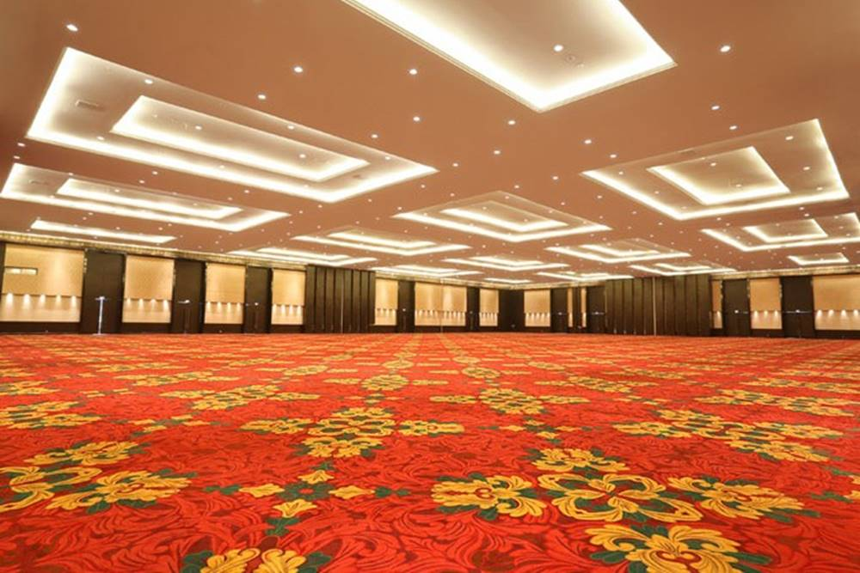
NUSA DUA HALL

Slide 12
Scheme Symposiums, 12 Oct 2024 (Day 3)
Pararel Symposium
APSDA + Closing
inaSN
Oral Research Presentation + Poster (Prefunction Room)

Slide 13
Scheme Symposiums, 13 Oct 2024 (Day 4)
Symposium
inaSN + Closing
YIA

Slide 14
Estimated location rental (includes lunch and coffee breaks)
WS (1 Days): Rp201.150.000,-
Sympo (3 Days): Rp2.733.750.000,-
Prefunction (2 Days): Rp537.094.800,-
Total: Rp3.471.994.800

Slide 15
Hotel and accommodation (ITDC)
Nusa Dua Beach Hotel and Spa
Courtyard by Marriot Bali Nusa Dua Resort
The St Regis Bali Resort
Sofitel
Novotel Bali Nusa Dua Hotel & Residences
Mercure Bali Nusa Dua
Kayumanis Nusa Dua Private Villa & Spa
Inaya Putri Bali
Grand Whiz Hotel Nusa Dua

Slide 16
Hotel and accommodation (ITDC)
Grand Hyatt Bali
Club Med Bali
Ayodya Resort Bali
Awarta Nusa Dua Luxury Villas & Spa
Amarterra Villas Bali Nusa
The Westin Resort Nusa Dua
The Laguna Resort & Spa
The Grand Bali Nusa Dua
Melia Bali

Slide 17
Planning
Determine the fix hotel for venue
Request funding from Indonesian Society of Nephrology (ISN) for the hotel down payment
ISN creates a local committee
To make MUO between APSDA and ISN (host)
Create a website and initial announcement
Create a WS and symphosium topic
Publication through international events
Seek sponsorship from industry
Preparation of WS materials and tools
Tentative local and international speakers

